Slide 1
Approximation algorithms 1 Set cover, vertex cover, scheduling
CS240 Spring 2024
Rui Fan

Slide 2




Approximation algorithms
Up to now, most of our algorithms have been exact. I.e. they find an optimal solution.
But there are many problems for which we don’t know how to find an optimal solution.
A key example is NP-complete problems. We don’t know efficient algorithms for any NPC problem.
Many such problems are important in practice. What do we do?
If we can’t get find the best answer, let’s try for good enough.
Approximation algorithms find an approximately optimal answer.

Slide 3
Approximation ratio
Let X be a maximization problem. Let A be an algorithm for X.
Let α>1 be a constant.
A is an α-approximation algorithm for X if A always returns an answer that’s at least 1/α times the optimal.
Ex If X is max-flow, A is a 2-approx algorithm if it always returns a flow that’s at least ½ the optimal.
The closer α is to 1, the better the approximation.
If X is a minimization problem, A is an α-approximation algorithm for X if it always returns an answer that’s at most α times larger than the optimal.
Ex If X is min-cut, A is a 2-approx algorithm if it always returns a cut that’s at most 2 times the size of the optimal.
Again, the closer α is to 1, the better the approximation.

Slide 4
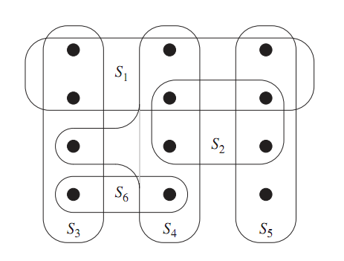
Coverings
Suppose there’s a set of teachers, and each can teach a certain set of classes.
Let S_{i} be the set of classes teach i can teach.
The entire set of classes is X.
We want to pick the minimum set of teachers to teach all the classes.
Let T be set of teachers we pick.
We want U_{i∈T} S_{i}=X, and T to be the smallest possible.

Slide 5
Set covering
Input A collection F of sets. Each set has a cost. The union of all the sets is X.
Output A subset G of F, whose union is X.
Goal Minimize the total cost of the sets in G.
Minimum cost set cover is NP-complete.
We’ll see a ln(n)-approximation algorithm, where n=|X|.
If all sets have same cost, S₃, S₄ and S₅ is a min cost set cover of X.

Slide 6
A greedy approximation alg
A natural greedy heuristic is to choose sets which cover points most cheaply.
For each set, let c be its cost, and m be the number of points it covers.
We want to use the set with the smallest c/m value, because this is the cheapest way to cover some new points.
After we pick this set, remove all the points it covers. Then we consider the per unit cost of the remaining sets and again choose the cheapest.

Slide 7
A greedy approximation alg
F is the entire collection of sets. The union of these sets is X.
Each set S in F has a cost cost(S).
U is the set of elements of X we haven’t covered yet.
C is the set cover we eventually output.
U = X
C = ∅
while U≠∅
choose S∈F-C with min |cost(S)|/|S∩U|
C = C∪{S}
U = U – S
output C
Per unit cost to cover new elements.

Slide 8
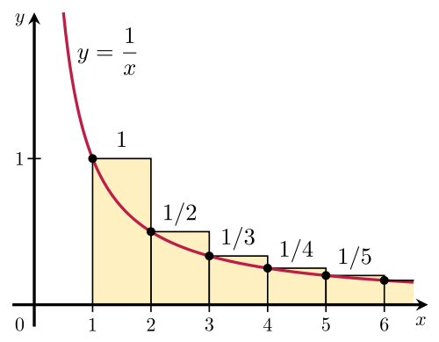
Proof of correctness
We always output a set cover, because the while loop continues till X is covered.
We’ll prove the approximation ratio is at most 1+1/2+1/3+...+1/n ≈ ln(n).
If the min cost of a set cover is V, our set cover costs at most ln(n)*V.
The basic plan is to bound the cost of the set cover the algorithm outputs using the “average cost” per element.

Slide 9
Proof of correctness
Order the sets in C by when they’re added to C, earliest set first.
Let the order be S₁, S₂,...,S_{m}.
Cost of the set cover is L=Σ_{i} cost(S_{i}).
Order the elements in X by when they’re added, earliest element first.
Let the order be e₁, e₂,...,e_{n}.
So, the first few e’s are added by S₁, the next few added by S₂, etc.
Every element in X is in the list, because C covers X.

Slide 10
Proof of correctness
Let n_{i} be the number of new elements S_{i} covers.
So, n_{i} is the number of elements in S_{i}, but not in S₁,...,S_{i-1}.
Divide the cost of S_{i} evenly among the new elements it covers.
If e is newly covered by S_{i}, then cost(e)= cost(S_{i})/n_{i}.
Σ_{k} cost(e_{k}) = Σ_{i} n_{i *}cost(S_{i})/n_{i} = Σ_{i} cost(S_{i}) = L.
Every element is covered by some S_{i}, and S_{i} covers n_{i} new elements.
We’ll prove cost(e_{k}) ≤ OPT/(n-k+1), for any k.
Suppose this is true, then
L = Σ_{k} cost(e_{k}) ≤ Σ_{k} OPT/(n-k+1) ≈ ln(n)*OPT

Slide 11
The per element cost
Let’s focus on some element e_{k}, and let S_{j} be the set which covers e_{k} for the first time.
Let C₁,...,C_{r} be the sets in an optimal cover, each of which covers some elements of U= {e_{k},e_{k+1},e_{k+2},...,e_{n}}.
Let n’₁,...,n’_{r} be the number of elements of U which C₁,...,C_{r} cover.
Obs 1 Σ_{i} n’_{i} ≥ n-k+1.
Because C₁,...,C_{r} cover U.
Obs 2 Σ_{i} cost(C_{i}) ≤ OPT.
Because C₁,...,C_{r} are a subset of an optimal cover, which has cost OPT.

Slide 12
The per element cost
Obs 3 None of C₁,...,C_{r} are among S₁,...,S_{j-1}.
If some C_{i} is among S₁,...,S_{j-1}, then since C_{i} covers some e in U, e would be covered by {S₁,...,S_{j-1}}. So, e would be among the first k-1 elements covered. Contradiction.
Obs 4 There exists some C_{i} among C₁,...,C_{r} with cost(C_{i})/n’_{i} ≤ OPT/(n-k+1).
If every C_{i} in C₁,...,C_{r} has cost(C_{i})/n’_{i}>OPT/(n-k+1), then
OPT ≥ Σ_{i} cost(C_{i}) = Σ_{i} n’_{i}*cost(C_{i})/n’_{i} >
Σ_{i} n’_{i}*OPT/(n-k+1) ≥ OPT/(n-k+1) Σ_{i} n’_{i} ≥
OPT/(n-k+1)*(n-k+1) = OPT.
Contradiction.

Slide 13
Proof of approximation ratio
Lemma cost(S_{j})/n_{j} ≤ OPT/(n-k+1).
Proof When choosing S_{j}, the only sets the algorithm is not allowed to choose are S₁,...,S_{j-1}.
By obs 3, C₁,...,C_{r} aren’t in S₁,...,S_{j-1}.
By obs 4, there’s some C_{i} in C₁,...,C_{r}, with cost(C_{i})/n’_{i} ≤ OPT/(n-k+1).
S_{j} was chosen so that cost(S_{j})/n_{j} is min among all sets not in S₁,...,S_{j-1}.
So cost(S_{j})/n_{j} ≤ cost(C_{i})/n’_{i} ≤ OPT/(n-k+1).
Since cost(S_{j})/n_{j} =cost(e_{k}), we have cost(e_{k})≤ OPT/(n-k+1).
The approx ratio follows because
L = Σ_{k} cost(e_{k})=Σ_{k} OPT/(n-k+1) ≈ ln(n)*OPT

Slide 14
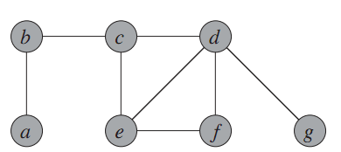
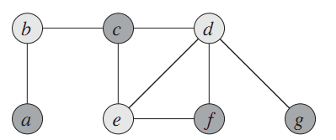
Vertex cover
Input A graph with vertices V and edges E.
Output A subset V’ of the vertices, so that every edge in E touches some vertex in V’.
Goal Make |V’| as small as possible.
Finding the minimum vertex cover is NP-complete.
Vertex cover is a special case of (unweighted) set cover, where each element (edge) can be covered by at most two sets (vertices).
We’ll see a simple 2 approximation for this problem.
source: Introduction to Algorithms, Cormen et al.

Slide 15
A vertex cover algorithm
Initially, let D be all the edges in the graph, and C be the empty set.
C is our eventual vertex cover.
Repeat as long as there are edge left in D.
Take any edge (u,v) in D.
Add {u,v} to C.
Remove all the edges adjacent to u or v from D.
Output C as the vertex cover.

Slide 16
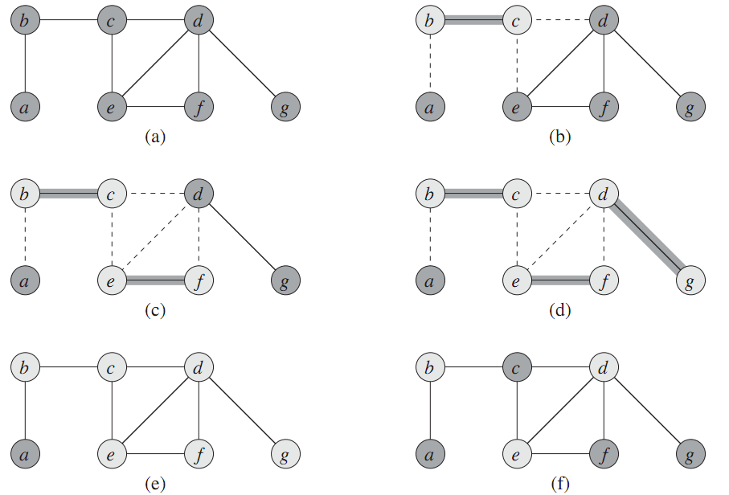
Example
source: CLRS
Algorithm’s vertex cover
Optimal vertex cover

Slide 17
Proof of correctness
The output is certainly a vertex cover.
In each iteration, we only take out edges that get covered.
We keep adding vertices till all edges are covered.
Now, we show it’s a 2 approximation.
Let C* be an optimal vertex cover.
Let A be the set of edges the algorithm picked.

Slide 18
Proof of Correctness
None of the edges in A touch each other.
Each time we pick an edge, we remove all adjacent edges.
So each vertex in C* covers at most one edge in A.
The edges covered by a vertex all touch each other.
Every edge in A is covered by a vertex in C*.
Because C* is a vertex cover.
So |C*| ≥ |A|.
The number of vertices the algorithm uses is 2|A|.
If alg picks edge (u,v), it uses {u,v} in the cover.
So (# vertices alg uses) / (# vertices in opt cover) = 2|A| / |C*| ≤ 2|A| / |A| = 2.

Slide 19
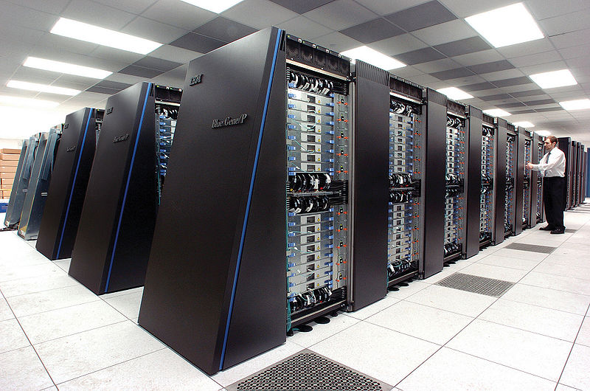


Parallel computing and scheduling
Computers today are parallel.
Multiple processors in a system.
Multiple tasks for the processors to run.
Multiprocessor scheduling is the problem of deciding which tasks to run on which processors at what time.
Many possible objectives.
Throughput, fairness, energy usage.
Latency, i.e. finishing all jobs as fast as possible.

Slide 20
Makespan scheduling
n independent jobs.
Jobs have different sizes, i.e. time needed to perform job.
Jobs can be done in any order.
Any job can be done on any machine.
m processors.
All have the same speed.
Each processors can do one job at a time.
Assign the jobs to the processors.
Makespan is when the last processor finishes all its jobs.
Minimize the makespan.
I.e., finish all the jobs as fast as possible.
makespan
p₁
p₂
m CPU’s
p₃
p₄
time

Slide 21
Minimizing makespan is NPC
Show that minimizing makespan on even two processors is NP-complete.
Decision version of problem is in NP.
SUBSET-SUM problem: Given a set of numbers S and target t, is there a subset of S summing to t?
Ex S={1,3,8,9}. For t=9, yes. For t=14, no.
SUBSET-SUM is NP-complete. Will reduce it to 2 processor makespan scheduling.
Let (S,t) be an instance of SUBSET-SUM, and let s be sum of all elements in S.
Make a set of tasks J = S∪{s-2t}, and schedule them on 2 processors.
Show that SUBSET-SUM reduces to min makespan, i.e. SUBSET-SUM has a solution iff min makespan has a certain solution.

Slide 22
Minimizing makespan is NPC
Claim If some subset of S sums to t, then min makespan is s-t.
Proof Say S’⊆S sums to t. Schedule the tasks in S’ and task s-2t on processor 1. So processor 1 finishes at time t+s-2t=s-t. Processor 2 does the tasks in S-S’, so it finishes at time s-t as well. Since processors finish at same time, the makespan is minimal.
Claim If the min makespan is s-t, there exists a subset of S that sums to t.
Proof Suppose WLOG processor 1 does the s-2t task. Since makespan is s-t, the other tasks processor 1 does must have total size s-t-(s-2t)=t.
So (S,t) is yes instance of SUBSET-SUM iff minimum makespan = s-t, so minimizing makespan is NPC.

Slide 23
Graham’s list scheduling
Since scheduling is NPC, it’s unlikely we can find the min makespan in polytime.
List scheduling is a simple greedy algorithm.
Finds a schedule with makespan at most twice the minimum.
A 2-approximation.
If there are n tasks and m processors, list scheduling only takes O(n log m) time.
Compare this to n! C(n+m-1, m-1) time to try all possible schedules and pick the best.

Slide 24
Graham’s list scheduling
List the jobs in any order.
As long as there are unfinished jobs.
If any processor doesn’t have a job now, give it the next job in the list.

Slide 25
Example
3 processors. The jobs have length 2, 3, 3, 4, 5, 6, 8.
List them in any order. Say 4, 5, 3, 2, 6, 8, 3.
Initially, no proc has a job. Give first 3 jobs to the 3 procs.
At time 3, proc 3 is done. Give it next job in list, 2.
At time 4, proc 2 is done. Give it next job in list, 6.
At time 5, both 1, 3 are done. Give them next jobs in list, 8,3.
Everybody finishes by time 13.
The makespan of this schedule is 13.
p₁
4
6
p₂
5
8
p₃
3
2
3

Slide 26
The worst case for LS
How badly can list scheduling do compared to optimal?
Say there are m² jobs with length 1, and one job with length m.
Suppose they’re listed in the order 1,1,1,...,1,m.
LS has makespan 2m. Optimal makespan is m+1.
makespan(LS) / makespan(opt) = 2m/(m+1) ≈ 2.
This is worst possible case for list scheduling.
m
m
m+1
m
m
makespan(LS) = 2m
makespan(opt) = m+1

Slide 27
LS is a 2-approximation
Next, we prove LS always gives a schedule at most twice the optimal.
Suppose LS gives makespan of M.
Let the optimal schedule have makespan M*.
We prove that M ≤ 2M*.

Slide 28
LS is a 2-approximation
T
M
p₁
p₂
X
m
p₃
p₄
t
The picture above is the schedule produced by list scheduling.
Consider task X that finishes last.
Say X starts at time T, and has length t.
Claim 1 M* ≥ t.
In any schedule, X has to run on some process.
Since X takes t time, every schedule, including the opt, takes ≥ t time.

Slide 29
LS is a 2-approximation
T
M
p₁
p₂
X
m
p₃
p₄
t
Claim 2 M* ≥ T.
Up to time T, no processor is ever idle.
Up to T, there’s always some unfinished job.
As soon as a processor finishes one job, it’s assigned another one.
So at time T, each processor completed T units of work.
So total amount of work in all the jobs is ≥ mT.
In the opt schedule, m processors complete at most m units of work per time unit.
So length of opt schedule is ≥ (total work)/m ≥ mT/m = T.

Slide 30
LS is a 2-approximation
T
M
p₁
p₂
X
m
p₃
p₄
t
From Claims 1 and 2, we have M* ≥ t and M* ≥ T.
So M* ≥ max(T,t).
M = T + t, because X is last job to finish.
So M/M* ≤ (T+t)/max(T,t) ≤ 2.

Slide 31
LPT scheduling
Worst case for LS occurred when longest job was scheduled last.
Large jobs are “dangerous” at end.
Let’s try to schedule longest jobs first.
Longest processing time (LPT) schedule is just like list scheduling, except it first sorts tasks by nonincreasing order of size.
Ex For three processors and tasks with sizes 2, 3, 3, 4, 5, 6, 8, LPT first sorts the jobs as 8,6,5,4,3,3,2. Then it assigns p₁ tasks 8,3, p₂ tasks 6,3, p₃ tasks 5,4,2, for a makespan of 11.
LPT has an approximation ratio of 4/3.

Slide 32
LPT is a 4/3-approximation
Thm Suppose the optimal makespan is M*, and LPT produces a schedule with makespan M. Then M ≤ 4/3 M*.
Let X be the last job to finish. Assume it starts at time T and has size t.
Assume WLOG that X is the last job to start.
If not, then say Y starts after T.
Y finishes before T+t. So we can remove Y without increasing the makespan.
Cor 1 X is the smallest job.
X is the last job to start, so due to LPT scheduling it’s the smallest.

Slide 33
LPT is a 4/3-approximation
Claim 1 LPT’s makespan = T+t ≤ M*+t.
As in LS, no processor is idle up to time T, so M* ≥ T.
Case 1 t ≤ M*/3.
Then LPT’s makespan ≤ M* + t ≤ M* + M*/3 = 4/3 M*.
Case 2 t > M*/3.
Since X is the smallest task, all tasks have size > M*/3.
So the optimal schedule has at most 2 tasks per processor. So n ≤ 2m.
If 1 ≤ n ≤ m, then LPT and optimal schedule both put one task per processor.
If m < n ≤ 2m, then optimal schedule is to put tasks in nonincreasing order on processors 1,...,m, then on m,...,1.
LPT also schedules tasks this way, so it’s optimal.

Slide 34
LS vs LPT
LPT gives better approx ratio, has same running time. Why bother with LS?
LS is online.
Imagine the jobs are coming one by one.
LS just puts them on any idle computer.
LPT is offline
It needs to know all the jobs that will ever arrive, in order to sort them.
In a realistic parallel computation, you get jobs on the fly.
Online is more realistic.
LS is usually more useful.

